Slide 1
Job requirements in a changing workplace

Slide 2
Job analysis
The process of determining the requirements of the job

Slide 3
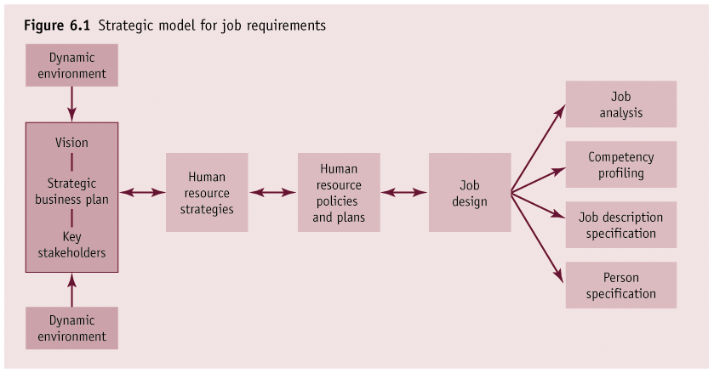

Slide 4
Job analysis and HR functions
Job analysis relates to:
Recruitment
Selection
Training and development
Performance management
Compensation management
Workplace relations

Slide 5
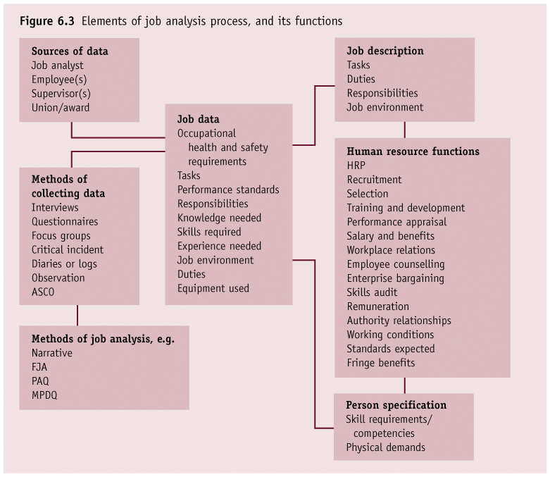

Slide 6
Performing job analysis
Select jobs
Determine information to collect
Identify sources of data
Methods of data collection
Evaluate and verify data
Write report

Slide 7
Key terms
Job
Position
Job requirements
Job specification
Job description

Slide 8
Methods of job analysis
Narrative
Functional job analysis (FJA)
Position analysis questionnaire (PAQ)
Threshold traits analysis
Other

Slide 9
Data collection methods
Interviews
Questionnaires
Job performance
Observation
Diaries
Critical incidents
Focus groups
HR records

Slide 10
Competency
A characteristic or trait that
results in effective performance
on the job

Slide 11
Competency profiling
Seeks to identify the specific set of competencies that are related to superior job performance
A competency is a skill, knowledge or any characteristic that results in effective job performance

Slide 12
Job descriptions and person specifications
Job description:
A written description of a job, the types of duties performed and the conditions under which these duties are performed
Person specification:
Details the qualifications, experience and personal qualities required of suitable job-holders

Slide 13
Job descriptions
Job title
Job Description
Job identification
1. Title.
2. Statement.
3. Essential Functions.
1. XXX
2. XXX
3. XXX
Essential functions
4. XXX
4. Specifications.
1. XXX
2. XXX
3. XXX
4. XXX
Job specifications

Slide 14
Job description problems
Often poorly written
Static rather than dynamic – not updated as job duties change
Sexist or discriminatory
Tasks not directly work-related
Vague rather than specific

Slide 15
Job design
Concerns the satisfaction
of the job holder’s
needs

Slide 16
Job design strategies
Job enlargement
Job rotation
Job enrichment
Self-managing work teams
Adjustments in work schedules

Slide 17
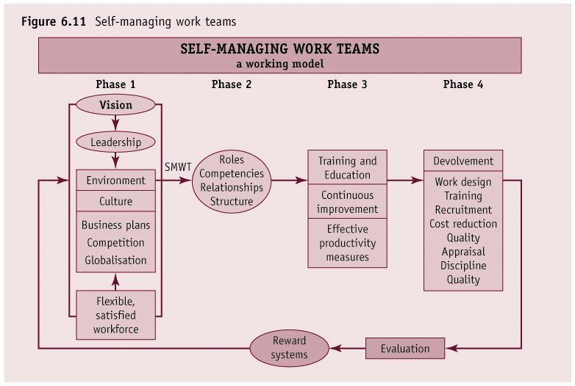

Slide 18
Work in the 21st century
Hours of work – longer and harder
Wage structures and reward programs
Job insecurity
Self-management
Workplace stress

